Slide 1
NoSQL Databases

Slide 2
Course Objectives:
Understand the different types of databases.
Explore Elasticsearch in detail as a search and analytics engine.
Know when and how to use Elasticsearch in various applications.
Visualize data with Kibana

Slide 3
Table of Content
JSON format
Reminder on traditional databases
Focus on ElasticSearch
Queries with Elasticsearch
Full text queries
Index Mapping
Geospatial Data with Elasticsearch
Kibana
Elasticsearch and Python

Slide 4
JSON format

Slide 5
JSON format
What is JSON (JavaScript Object Notation)?
JSON is a lightweight, human-readable data format used for exchanging structured data between a server and a client, as well as for data storage. It is based on a key-value syntax and is widely used in web development and applications.
Structure of a JSON File
A JSON file consists of JSON objects ({}), JSON arrays ([]), key-value pairs, strings, numbers, booleans, and null values.
{
"name": "John Doe",
"age": 30,
"city": "New York"
}

Slide 6
Advantages and uses of json
Advantages of JSON
Lightweight and human-readable.
Supports complex data structures.
Widely used in web APIs.
Compatible with many programming languages.
Uses of JSON
Storing configuration data.
Exchanging data between clients and servers.
Storing structured data.
Used in formats like GeoJSON for geospatial data.

Slide 7
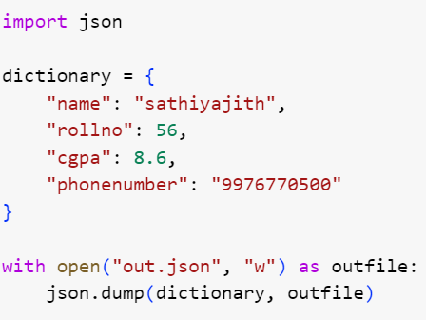
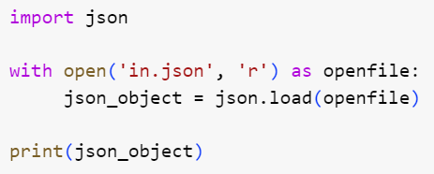
Manipulating JSON with Python
Python provides a built-in library called json for easy manipulation of JSON files. You can import it with import json.
Write
Read

Slide 8

Your turn !
Load the data from the "energy_data.json" file using Python.
Filter out energy plants with a capacity greater than 40 MW.
Calculate the total capacity of all remaining power plants.
Identify the power plant closest to latitude 35.0 and longitude -120.0 using the haversine distance formula.
Create a new JSON file named "filtered_energy_data.json" containing information on the filtered energy plants, the total capacity and details of the nearest plant.

Slide 9
Reminder on traditional databases

Slide 10

What is a database ?
Definitions and Basic Database Concepts
Storing data to serve as many application as needed
Permit update/delete and search on data

Slide 11
Types of databases
Relational Databases: Organize data into tables and establish relationships between them.
MySQL, PostgreSQL, SQL Server...
NoSQL Databases: Offer flexibility and ability to handle various data types. : document, graph, column-family, and key-value stores.
MongoDB, Neo4j, Cassandra, Redis...
NewSQL Databases: Combine the best of both relational and NoSQL worlds.

Slide 12
From relational DB to documents
Document = autonomous or quasi-autonomous unit of information.
→ Little or no reference to other documents.
→ Little or no structure; or a very flexible structure.
→ Content often multimedia-oriented.
Examples
Text documents, Web document types.
images, audio documents, videos; no explicit structure, production of synthetic descriptors to try to index them.
All files on your computer.
Etc.

Slide 13
From relational DB to documents
In a file system? Why not, but :
laborious handling, no content control, insecure, primitive search function
Really impractical for building applications
In a relational database? Why not, but :
Under-utilization of the system (BLOB storage, unusable SQL, elementary transactions)
Little gain
In a document-oriented system?
A document database = DB functionalities, specialized documents

Slide 14
From relational DB to documents
In document databases, little or no fixed structure :
Unsuitable SQL
Exact" search often unsatisfactory
A good search is often based on similarity:
A "query" document is provided
The system searches for documents close to the query document
Implies a notion of distance, and therefore a ranking of the result
Par exemple, quand on recherche sur le Web :
On fournit un ensemble de mots-clés : c'est le document requête
Le moteur de recherche trouve les documents les plus proches
Le classement et sa pertinence sont des éléments essentiels
For example, when searching the Web :
You provide a set of keywords: this is the query document
The search engine finds the closest documents
Classification and relevance are essential elements

Slide 15
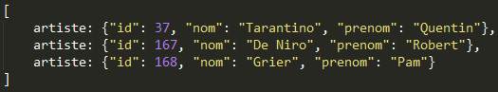
From relational DB to documents
id | nom | prénom
37 | Tarantino | Quentin
167 | De Niro | Robert
168 | Grier | Pam
Example of a table :
Representation in the form of a document:
Relational table = tree of constant height.
Three levels: row, attribute, value.

Slide 16
From relational DB to documents
In a relational database, data is highly constrained/structured: structure (schema) and content (database) can be stored separately.
A JSON (or XML) tree representation is more appropriate for data with a complex and/or flexible structure.
Thanks to the nesting of structures, it is possible to represent data with arbitrary complexity.

Slide 17
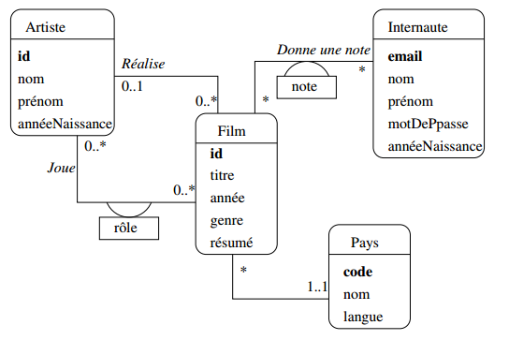
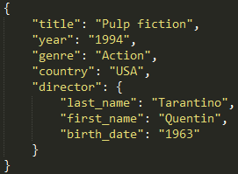
From relational DB to documents

Slide 18
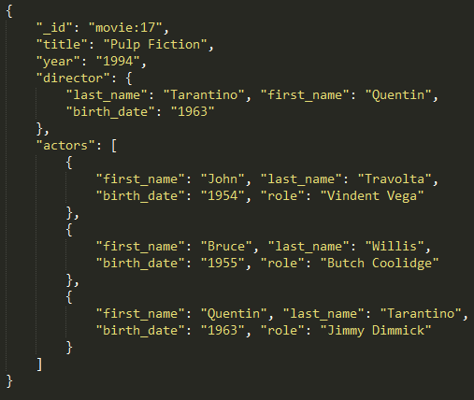

Slide 19
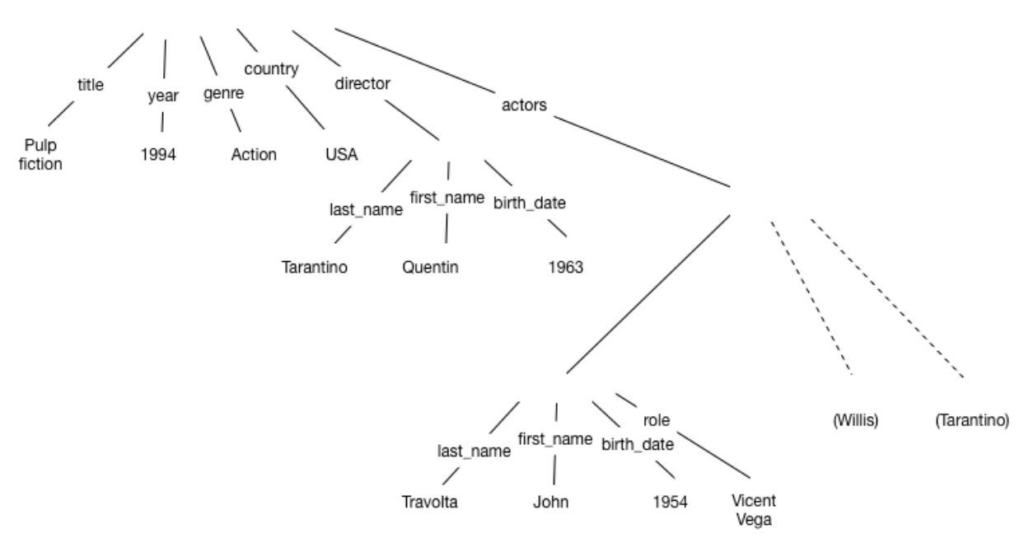
Drawbacks
Privileged access path: Films appear near the root of documents, artists are buried in the depths; access to films is therefore privileged.
Preferring an access path is good for some applications, bad for others.
Redundancy: The same information has to be represented several times, which is quite unfortunate (Quentin Tarantino is represented twice).
Redundancy leads to inconsistencies.

Slide 20
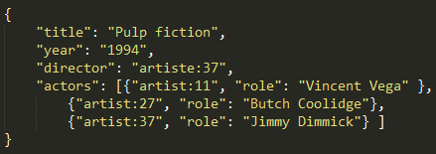
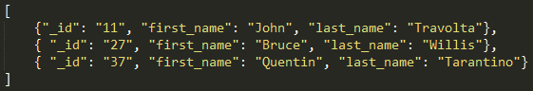
Combine documents

Slide 21
If the data in a relational database can be represented by a text document, the following questions must always be asked:
Does it represent a regular structure (e.g. a table)? If so, it's not necessary to integrate structure and content. You can create the structure, then integrate the content (DBMS).
Do I need to include references to identifiable entities? Document templates are not suitable for content with a high density of references to entities.
Is the structure of a document fixed and predictable?
Counter-example: the written report

Slide 22
Advantages and drawbacks
 | Advantages | Drawbacks
Relational Databases | - Data consistency: Ensures that data is accurate and reliable. - Structured querying: Supports SQL for powerful and flexible queries. - Established standards: Well-defined standards and best practices. | - Limitations in handling unstructured or semi-structured data: Challenges with data types like JSON or XML. - Complex schemas: Schemas can be rigid and require changes for new data.
NoSqlDatabase | - Scalability: Easily scales horizontally to handle large datasets and high traffic. - Schema flexibility: Accommodates dynamic and evolving data structures. - Performance in specific use cases: Can excel in scenarios like real-time data or high write loads. | - Potential data inconsistency: Less rigid schema enforcement may lead to data integrity challenges. - Absence of standardized query languages: NoSQL databases often lack a universally accepted query language, making it harder to transition between systems.

Slide 23
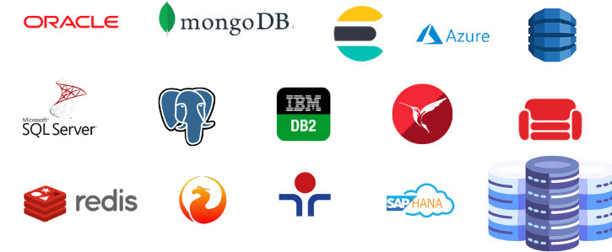
How to choose the correct database ?
The decision should align with the specific needs of your project.

Slide 24
Focus on ElasticSearch

Slide 25
Lucene
The most widely used open indexing and search engine
Java library containing customized full-text search functions:
Results sorted by relevance
Phrase analysis
Field search
Lemmatization
Complex queries
Etc.

Slide 26
Lucene
But does not contain :
A content transformer
A user interface
A permissions manager or index distribution mechanism
It leaves it up to the programmer to develop, connect and configure all the components required to offer search functionality to his application.
It is therefore integrated into a multitude of applications (CMS, document management, web portals, etc.):
Liferay, Alfresco, Nuxeo, Hadoop, OpenCMS, eXo Platform, xWiki, iBM Enterprise Search, Documentum, JiRA and many others.
Websites such as eBay, Amazon, AOL, eHarmony and Macy's have also relied on Lucene for their search functionalities.

Slide 27
Lucene
But also in dedicated search applications such as Solr, Nutch or ElasticSearch, integrating new functionalities:
Faceted search
Synonym management
Complex query analyzers
Filters
Mathematical functions for relevance calculation
Connector mechanisms to add various functionalities and manage their configuration
Etc.
But above all, advanced tools for scaling and distributing indexes across multiple servers!

Slide 28

ElasticSearch story
Elasticsearch is a real-time distributed search and analysis tool originally developed by Shay Banon to create a recipe search engine for his wife.
2010, first public version

Slide 29


ElasticSearch
Dependencies and features
Elasticsearch requires :
Apache Lucene™, a full-text search engine
Java, so JVM is required

Slide 30



Who use ElasticSearch today ?
Uber, Tinder, Shopify …
And so many more !

Slide 31
What is elasticstack
Kibana
Elasticsearch
Beats
Logstash
🡪 Take data from anys source, and any format then search, analyse and visualise
🡪 Free and open source since the beginning

Slide 32
Elasticsearch use cases
Logging (Blizzard Video games)
Metrics (Nasa to store tempearture on mars for example: )
Security analytics (Slack)
Business analytics (Tinder helping getting a match by finding people closed to you)

Slide 33
What is ElasticSearch ?
Elasticsearch is a powerful and versatile open-source search and analytics engine designed for handling large volumes of data, with several key characteristics:
Real-Time Search: Elasticsearch provides real-time search capabilities, allowing users to access and query data immediately after it's indexed.
Distributed and Scalable: It is distributed and scalable, making it suitable for handling large datasets and providing high availability and fault tolerance.
Full-Text Search: Elasticsearch excels in full-text search, enabling complex text-based queries and relevance ranking.
Ecosystem: It is part of a broader ecosystem, including components like Logstash and Kibana for data ingestion and visualization.
Wide Range of Use Cases: Elasticsearch is used in various applications, from e-commerce product searches to log analysis and monitoring in IT operations.

Slide 34
Elasticsearch cluster

Slide 35
Data storage
Data is stored as a document, as a json object with a unique Id
{
"_id": 2,
"name": "Jane Smith",
"email": "jane.smith@example.com",
"age": 25
}

Slide 36
Index
Documents that are related to each others are grouped into index
Index : products
Index : users
{
"_id": 1,
"name": “Smartphone",
“price": 800,
“brand": “XYZ Tech
}
{
"_id": 2,
"name": “Camera",
“price": 500
“brand": “CameroCo”
}
{
"_id": 2,
"name": "Jane Smith",
"email": "jane.smith@example.com",
"age": 25
}
{
"_id": 3,
"name": “Tom Durand",
"email": “tom.durand@example.com",
"age": 42
}

Slide 37
Elasticsearch Cluster
Elasticsearch Cluster
Node 1
products
Shard 1
users
Shard 1
Shard 1

Slide 38

Elasticsearch Cluster
Elasticsearch Cluster
Node 1
There is not enough space on my node for all my data
products
Shard 1
users
Shard 1
Shard 1

Slide 39
Elasticsearch Cluster
Elasticsearch Cluster
Node 1
Node 2
Node 3
products
Shard 1
Shard 2
Shard 3
users
Shard 2
Shard 3
Shard 1
Shard 2
Shard 1

Slide 40
Elasticsearch Cluster
Elasticsearch Cluster
Nœud 1
Nœud 2
Nœud 3
I want to be sure that my data is safe even if i lose a node
products
Shard 1
Shard 2
Shard 3
users
Shard 2
Shard 3
Shard 1
Shard 2
Shard 1

Slide 41
Elasticsearch Cluster
products
Elasticsearch Cluster
Node 1
Node 2
Node 3
Node 4
Node 5
Node 6
Shard 1
Shard 2
Shard 3
Replica 1
Replica 2
Replica 3
Shard 2
Replica 3
Shard 1
Shard 3
Replica 1
Replica 2
Shard 2
Shard 1
Replica 1
Replica 2
users

Slide 42
Elasticsearch Cluster
Elasticsearch Cluster
Node 1
Node 2
Node 3
Node 4
Node 5
Node 6
Shard 1
Shard 2
Shard 3
Replica 1
Replica 2
Replica 3
Shard 2
Replica 3
Shard 1
Shard 3
Replica 1
Replica 2
Shard 2
Shard 1
Replica 1
Replica 2
{
"_id": 2,
"name": "Jane Smith",
"email": "jane.smith@example.com",
"age": 25
}
{
"_id": 3,
"name": “Tom Durand",
"email": “tom.durand@example.com",
"age": 42
}

Slide 43
ElasticSearch Cluster
ElasticSearch operates as a distributed system, and its primary components include nodes, shards, and replicas.
Nodes: Individual instances of ElasticSearch that make up the cluster.
Shards: Divisions of data within an index that allow for parallelism and scalability.
Replicas: Duplicate copies of primary shards to ensure data availability and fault tolerance.

Slide 44
Searching documents
Lucene
Each node has runs a Lucene instance

Slide 45
Searching documents
Elasticsearch Cluster
Node 1
products
Shard 1
6000 documents by shard
users
Shard 1
Shard 1

Slide 46
Searching Documents
Elasticsearch Cluster
Node 1
Node 2
Node 3
products
Shard 1
Shard 2
Shard 3
users
Shard 2
Shard 3
Shard 1
Shard 2
Shard 1
2000 documents by shard
We increase the search speed by 3 !

Slide 47
Your turn !
Deploy an elasticsearch cluster with 2 nodes thanks to docker compose
Scale up your cluster and add replicas

Slide 48
Basic queries
Syntax : GET _API/parameter
To get cluster health
GET _CLUSTER/health
To get nodes parameters
GET _NODES/stats

Slide 49
CRUD operations
C – Create
Create an index
Syntax:
PUT Name-of-the-Index
Example:
PUT favorite_candy

Slide 50
CRUD operations
C – Create
Index a document
When indexing a document, both HTTP verbs POST or PUT can be used.Use POST when you want Elasticsearch to autogenerate an id for your document.
Example:
POST favorite_candy/_doc
{
"first_name": "Lisa",
"candy": "Sour Skittles"
}
Syntax:
POST Name-of-the-Index/_doc
{
"field": "value"
}

Slide 51
CRUD operations
C – Create
Index a document
Use PUT when you want to assign a specific id to your document (i.e. if your document has a natural identifier - purchase order number, patient id, & etc).
Example:
PUT favorite_candy/_doc/1
{
"first_name": "John",
"candy": "Starburst"
}
Syntax:
PUT Name-of-the-Index/_doc/your-id
{
"field": "value"
}

Slide 52
CRUD operations
R - READ
Read a document
Syntax:
GET Name-of-the-Index/_doc/id
Example:
GET favorite_candy/_doc/1

Slide 53
CRUD operations
U - UPDATE
Update a document
Syntax:
POST Name-of-the-Index/_update/id
{
"doc": {
"field1": "value",
"field2": "value",
}
}
Example:
POST favorite_candy/_update/1
{
"doc": {
"candy": "M&M's"
}
}

Slide 54
CRUD operations
D - DELETE
Delete a document
Syntax:
DELETE Name-of-the-Index/_doc/id
Example:
DELETE favorite_candy/_doc/1

Slide 55
CRUD operations
C – Create
Index a document
When you index a document using an id that already exists, the existing document is overwritten by the new document. If you do not want a existing document to be overwritten, you can use the _create endpoint!
With the _create Endpoint, no indexing will occur and you will get a 409 error message.
Syntax:
PUT Name-of-the-Index/_create/your-id
{
"field": "value"
}
Example:
PUT favorite_candy/_create/1
{
"first_name": "John",
"candy": "Starburst"
}

Slide 56
Your turn !
Create an index called destinations.
Pick five dream travel destinations. For each destination, index a document containing the name and the country.
Read(GET) each document to check the content of the document.
Update a field of a document.
Read(GET) the updated document to ensure that the field has been updated.
Delete a document of one place.

Slide 57
Queries

Slide 58
https://github.com/LisaHJung/Part-2-Understanding-the-relevance-of-your-search-with-Elasticsearch-and-Kibana-
Livre ES

Slide 59
Queries
The query DSL is a flexible, expressive search language that Elasticsearch uses to expose most of the power of Lucene through a simple JSON interface.
Syntax:
GET name-of-the-Index/_search
{
"query": YOUR_QUERY_HERE
}

Slide 60
Query structures
A query clause typically has this structure:
If it references one particular field, it has this structure:
{
QUERY_NAME: {
ARGUMENT: VALUE,
ARGUMENT: VALUE,...
}
}
Example:
GET favorite_candy/_search
{
"query": {
"match": {
“candy": “M&M’s"
}
}
}
{
QUERY_NAME: {
FIELD_NAME:
ARGUMENT: VALUE,
ARGUMENT: VALUE,..
}.
}
}

Slide 61
Create complex queries
Query clauses are simple building blocks that can be combined with each other to create complex queries.
Leaf clauses (like the match clause) that are used to compare a field to a query string.
Compound clauses that are used to combine other query clauses. For instance, a bool clause allows you to combine other clauses that either must match, must_not match, or should match if possible:

Slide 62
Example:
GET favorite_candy/_search
{
"bool": {
"must": { "match": { “candy": “M&M’s" }},
"must_not": { ”match”: { “first_name": "mary" }},
}
}
Compound clause can combine any other query clauses,
including other compound clauses. This means that compound clauses can be nested within each other, allowing the expression of very complex logic.

Slide 63
Query vs Filter
Filter asks a yes|no question of every document and is used for fields that contain exact values.
A query is similar to a filter, but also asks the question: How well does this document match?
A query calculates how relevant each document is to the query, and assigns it a relevance _score, which is later used to sort matching documents by relevance. This concept of relevance is well suited to full-text search, where there is seldom a completely “correct” answer.
As a general rule, use query clauses for full-text search or for any condition that
should affect the relevance score, and use filter clauses for everything else.

Slide 64
Most common queries and filters
term Filter
The term filter is used to filter by exact values, be they numbers, dates, Booleans, or not_analyzed exact-value string fields:
{
{ "term": { "age": 26 }}
{ "term": { "date": "2014-09-01" }}
{ "term": { "public": true }}
{ "term": { "tag": "full_text" }}
}

Slide 65
Most common queries and filters
terms Filter
The terms filter is the same as the term filter, but allows you to specify multiple values to match. If the field contains any of the specified values, the document matches:
{
"terms": { "tag": [ "search", "full_text", "nosql" ] }
}

Slide 66
Most common queries and filters
range Filter
The range filter allows you to find numbers or dates that fall into a specified range:
The operators that it accepts are as follows:
gt : Greater than
gte : Greater than or equal to
lt : Less than
lte : Less than or equal to
{
"range": {
"age": {
"gte": 20,
"lt": 30
}
}
}

Slide 67
Most common queries and filters
exists and missing Filters
The exists and missing filters are used to find documents in which the specified field either has one or more values (exists) or doesn’t have any values (missing)
{
"exists": {
"field": "title"
}
}

Slide 68
Most common queries and filters
Bool Filters
The bool filter is used to combine multiple filter clauses using Boolean logic. It accepts three parameters:
must : These clauses must match, like and.
must_not : These clauses must not match, like not.
should : At least one of these clauses must match, like or.

Slide 69
Search for information
There are two main ways to search in Elasticsearch:
Queries : to retrieve documents that match the criteria.
Aggregations : to summarizes your data as metrics, statistics, and other analytics.

Slide 70
Queries
Syntax:
GET name_of_the_index/_search
{
"query": {
"Specify the type of query here": {
"Enter name of the field here": {
"gte": "Enter lowest value of the range here",
"lte": "Enter highest value of the range here"
}
}
}
}
Example:
GET favorite_candy/_search
Elasticsearch displays a number of hits and a sample of 10 search results by default.

Slide 71
Index mappings

Slide 72
Mapping
Mapping is the process of defining the fields/structure that documents follow and how they are stored and indexed on ES.
Mapping is generally used to define :
which string fields should be treated as full text fields
Which fields contain numbers, dates or geolocation
Whether the values of all fields in the document should be indexed in the _all field
Date format
Etc.
Each field has a data type, which can be :
A simple data type such as string, date, long, double, boolean or ip.
A type that supports the hierarchical nature of JSON, such as object or nested.
A special type such as geo_point, geo_shape or completion.

Slide 73
Mapping
Create a new index with a mapping :
Create a mapping on an existing index :
PUT /my_index?pretty
{
"settings": {
"number_of_shards": 1
},
"mappings": {
"properties": {
"name": {
"type": "text"
},
"age": {
"type": "integer"
}
}
}
}
PUT /my_index/_mapping?pretty
{
"properties": {
"email": {
"type": "keyword"
}
}
}
Retrieve the mapping :
Curl -XGET localhost:9200/my_index/_mapping
Notes:
https://www.elastic.co/guide/en/elasticsearch/guide/current/nested-mapping.html

Slide 74
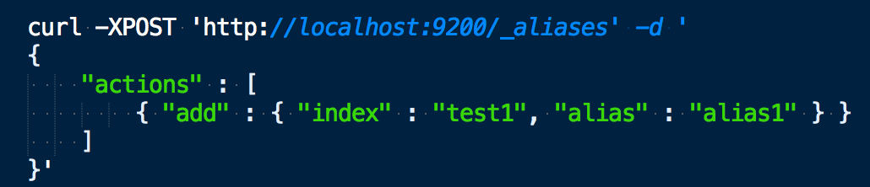
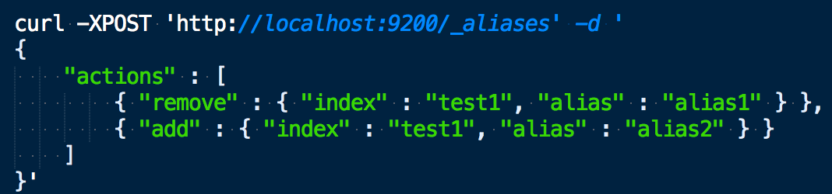
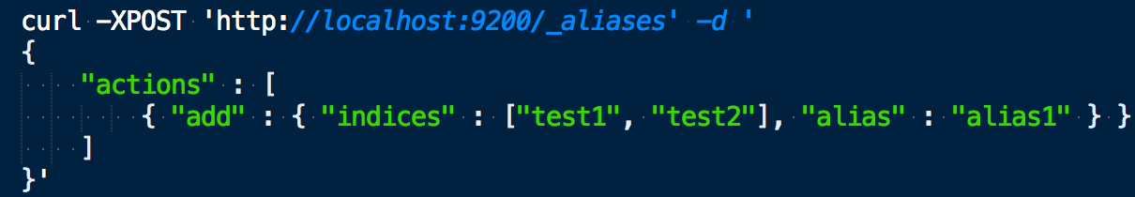
Alias
Virtual index name that can point to one or more real indexes
Facilitates redirection of _search queries
No need to modify the _search endpoint
Add an alias "alias1" to the "test1" index
Rename "alias1
Association of "alias1" with
test1" and "test2" indexes

Slide 75
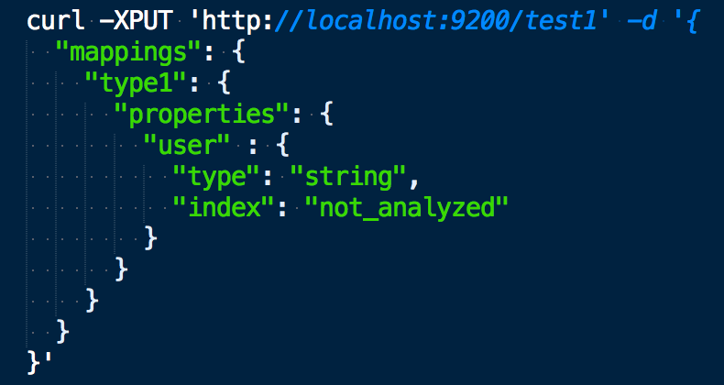
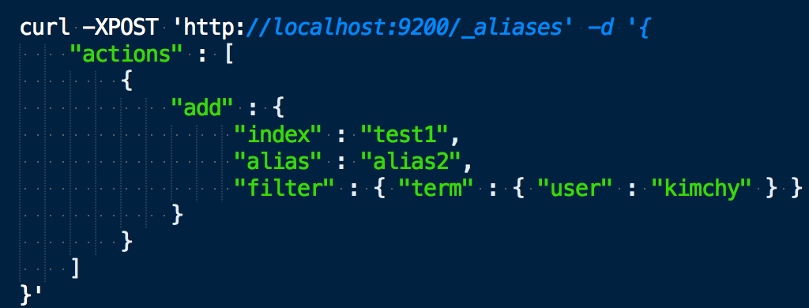
Alias
Pour créer un alias avec filtre sur un champs, nous devons d’abord être sûr que ce champs existe dans le mapping
On peut maintenant créer un alias “alias2” qui utilise un filtre sur le champs user

Slide 76
Full text queries

Slide 77
https://github.com/LisaHJung/Part-3-Running-full-text-queries-and-combined-queries-with-Elasticsearch-and-Kibana

Slide 78
Information Retrieval
Information Retrieval (IR) is the process of finding documents in a large
documents with little or no structure, in a large collection, according to an information need.
IR develops models for :
interpret documents and needs, and bring them together
calculate answers quickly, even in the presence of very large
collections
search engine" systems providing sophisticated,
ready-to-use solutions.
Applications
Web search, used daily by billions of users
Searching messages in your mailbox
Searching for files on your computer
Searching for sources in a public or private document database
etc.

Slide 79
Lemmatization & Stemming
Lemmatization
Transforms a word into a canonical form (lemma) by standardizing gender (masculine or feminine), number (one or more), person (me, you, them...), mode (indicative, imperative...).
seeks → seek
dogs → dog
Stemming
Transforms a word into a radical or root. The affixes (suffixes, prefixes, postfixes, antefixes) are removed, leaving only the root.
Sometimes same result as the lemmatization:
fishing, fished, fish, fisher → fish
Source of error sometimes: university, universe → univers

Slide 80
How to represent a document?
TF-IDF
One-hot vector encoding
doc2vec
Bag of Words
skip-though vectors
Transformers
word2vec

Slide 81
Elasticsearch for geospatial data

Slide 82
https://www.elastic.co/guide/en/elasticsearch/reference/current/geospatial-analysis.html#:~:text=Elasticsearch%20supports%20two%20types%20of,to%20index%20geo%20data%20fields.

Slide 83
Geospatial data representation
To represent geospatial data in ElasticSearch, you have two data types:
“geo_point”
“geo_shape”

Slide 84
Geo Point
geo_point
fields accept latitude-longitude pairs, which can be used:
to find geo-points within a bounding box, within a certain distance of a central point, or within a polygon.
to aggregate documents geographically or by distance from a central point.
to integrate distance into a document’s relevance score.
to sort documents by distance.

Slide 85
Geo shape
geo_shape
With this data type you can have more representation geospacial data :
Point: defined by an one point with latitude and longitude.
Linestring: defined by an array of two or more positions.
Polygon: defined by a list of a list of points.
Multipoint: a list of geojson points.
Multilinestring: is an example of a list of geojson linestrings.
Multipolygon: list of geojson polygons.
Geometrycollection: collection of geojson geometry objects.
Envelope: consists of coordinates for upper left and lower right points of the shape to represent a bounding rectangle in the format [[minLon, maxLat], [maxLon, minLat]] .
Circle: consists of a center point with a radius.

Slide 86
Geospatial queries
You can search by:
geo_bounding_box: query to finds documents with geo-points that fall into the specified rectangle.
geo_distance: query to finds documents with geo-points within the specified distance of a central point.
geo_polygon: query to find documents with geo-points within the specified polygon.
geo_shape query: to finds documents with geo-shapes which either intersect, are contained by, or do not intersect with the specified geo-shape.

Slide 87
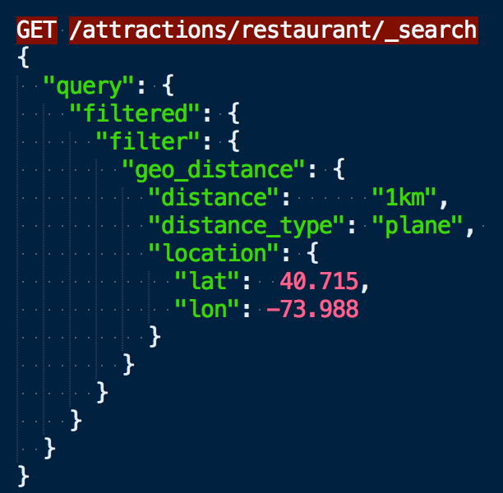
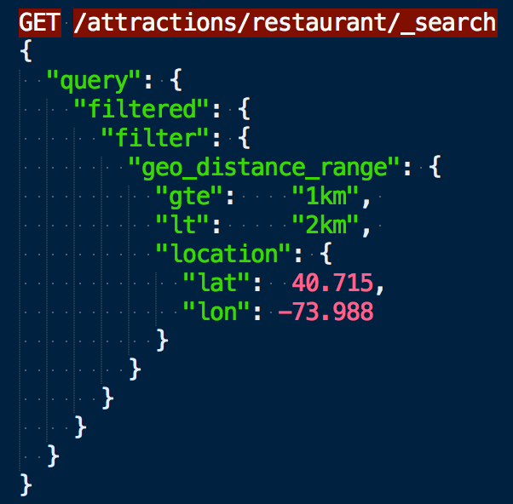
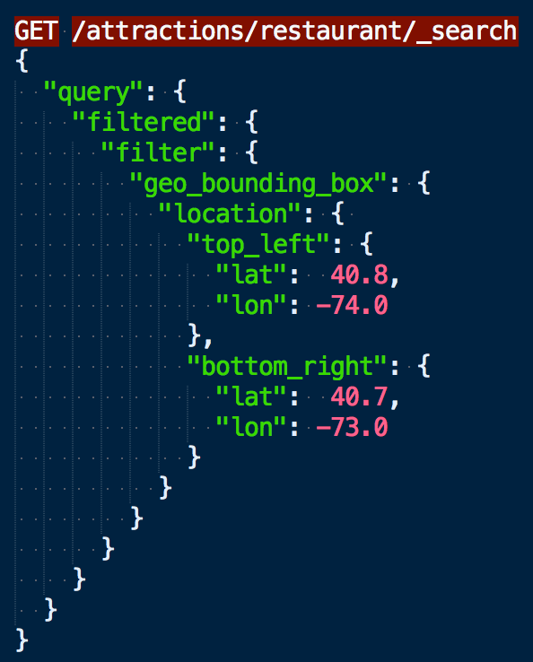
Geospatial search
Filtre par Geo Point
Geo distance, geo distance range et geo bounding box
Notes:
distance_type
How to compute the distance. sloppy_arc (default) arc (slightly more precise but significantly slower) plane (faster, but inaccurate on long distances and close to the poles).

Slide 88
Kibana

Slide 89
Kibana
Kibana started out as a Logstash interface project. Today, it's the official Elasticsearch interface.
You can use it to view and search log messages and other system events, but it's by no means limited to that. Kibana lets you query and visualize any data contained in Elasticsearch.
Numerous graphical components are available to give a visual dimension to the data stored in Elasticsearch. Dashboard creation is intuitive thanks to a WYSIWYG interface (no code to create).
The resulting dashboards can be used by developers and technical staff, as well as by business contacts and managers.

Slide 90
Kibana
Web interface :
→ Construction of elasticsearch queries, filters and aggregations
→ Facilitates the creation of queries and filters by proposing their construction through
simple mouse selection
→ Offers a set of graphs for representing aggregation results

Slide 91
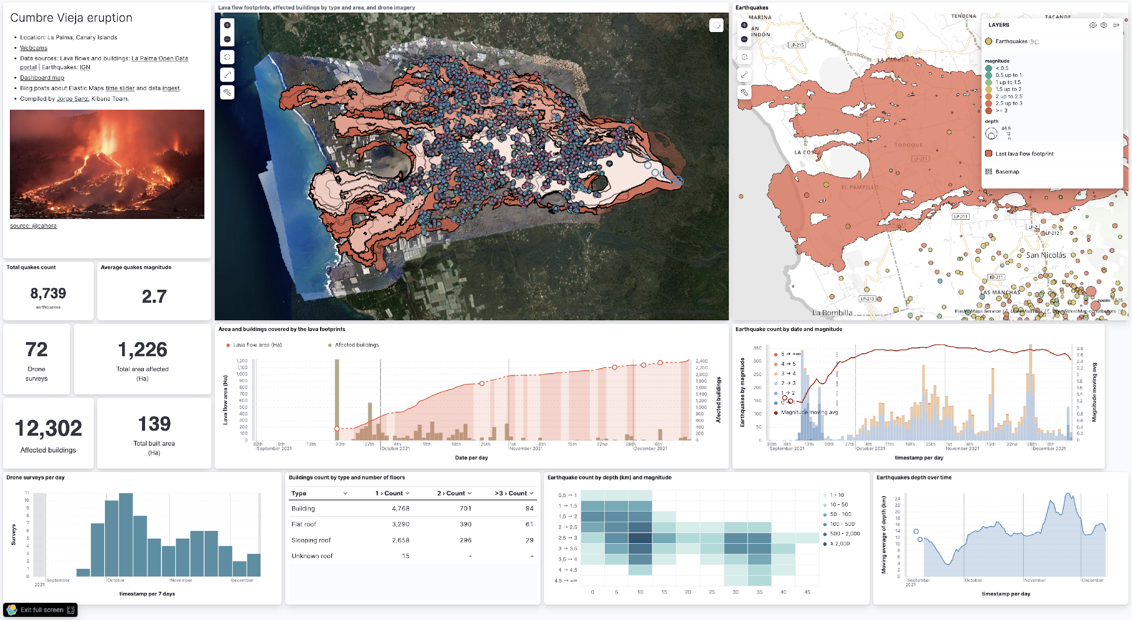
Vizualize your data

Slide 92
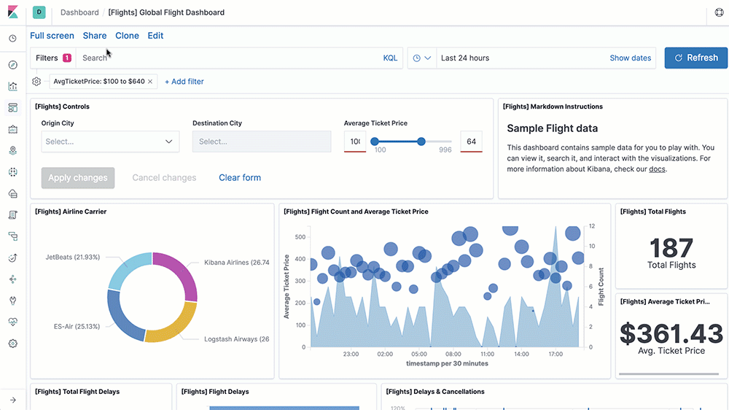
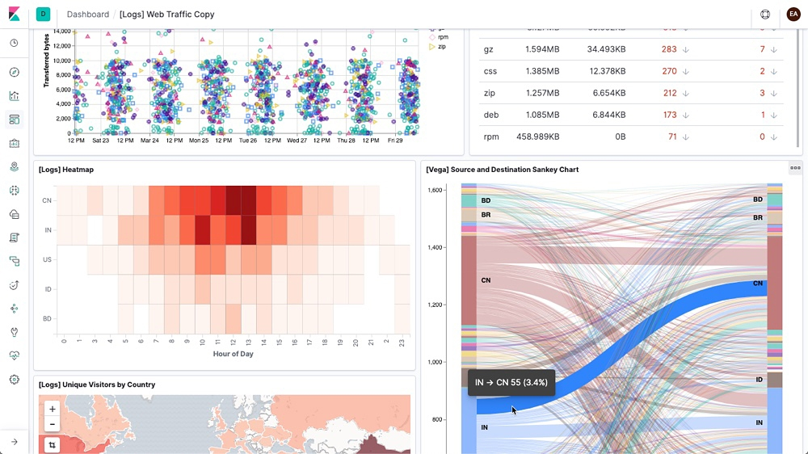
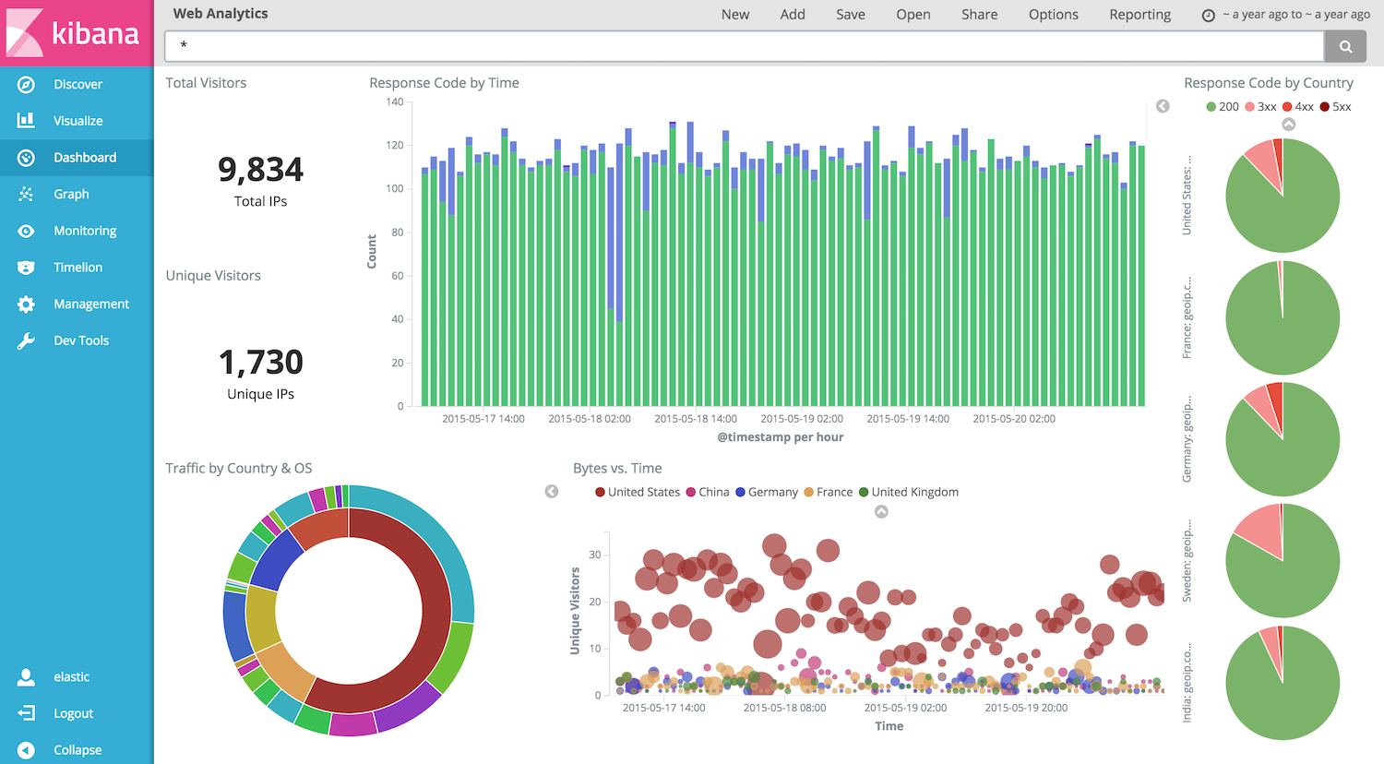
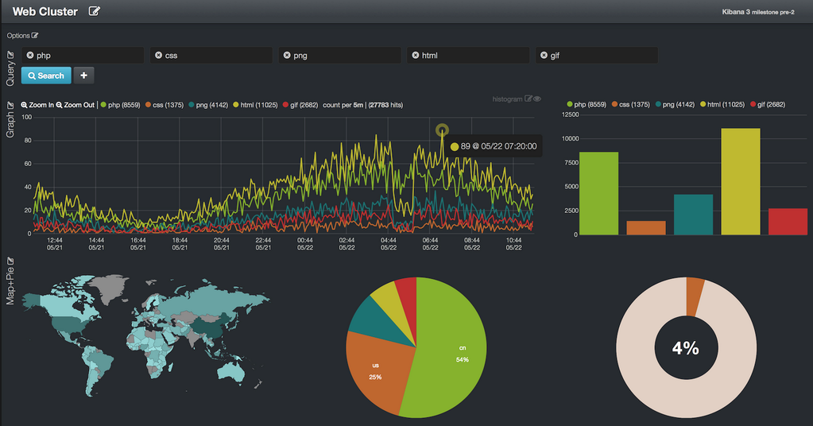
Kibana

Slide 93
Your turn !
Add a Kibana to your local stack
Build your first Dashboard based on the data your previously injected
Inject the given CSV file in a new index and visualize data

Slide 94
Elasticsearch and Python

Slide 95
Elasticsearch
Elasticsearch DSL

Slide 96
Your turn !
Manipulate data in Elastic with Python

Slide 97
Thank you !

Slide 98
Annexes

Slide 99
MongoDB

Slide 100
MongoDb cluster
MongoDB and the Document Model
Connecting to a MongoDB Database
MongoDB CRUD Operations: Insert and Find Documents

Slide 101
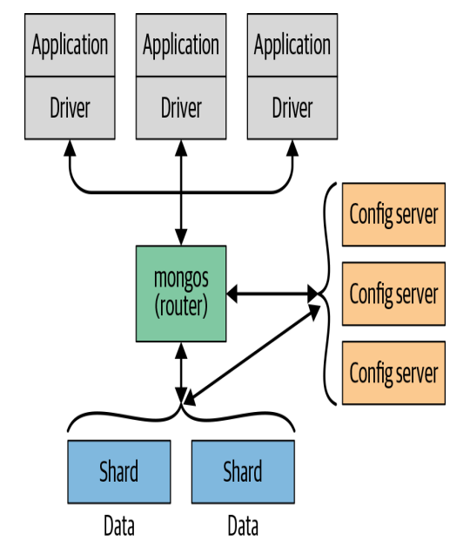

Slide 102
Document : the basic unit stored in MongDB
Collection: grouping of documents
Database: container for collections

Slide 103
Documents are displayedjson
Stored in BSON, binary json
Bson supports additional data types like dates, numbers and objectIds
_id field act as primary field

Slide 104
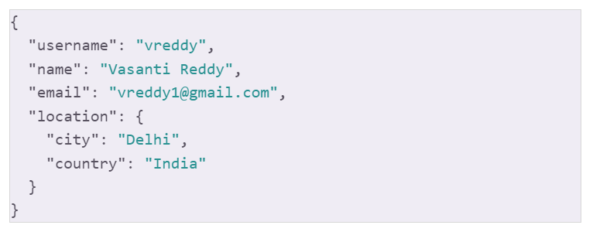
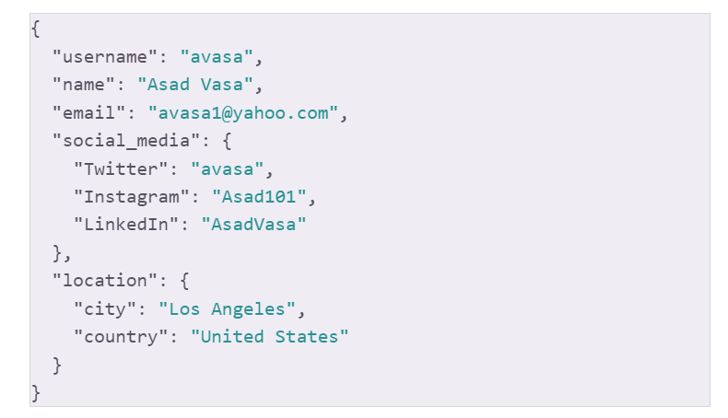
Documents may contain diffetrents fields
Fields may contain differents types
→ Flexible schema can be modiefied at any time

